Slide 1
Example screens from JavaFX
by add32

Slide 2
Setting nicknames

Slide 3
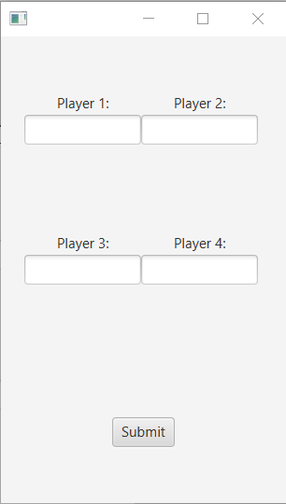
Windows is made out of 4 text field which must be filled up to proceed to the next step.

Slide 4
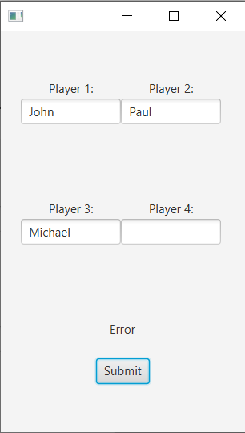
If any nickname is missed, appropriate next message will be displayed above the button.

Slide 5
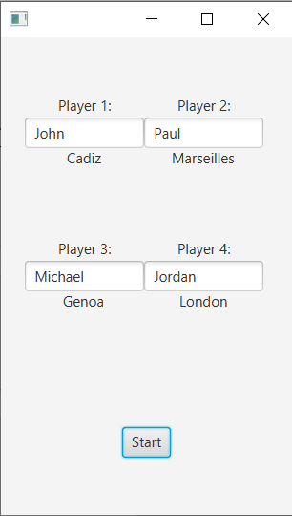
In other case, ports will be randomly assigned to the players and game can be started by pressing the start button.

Slide 6
Board prototype

Slide 7
